Slide 1

UIUX DESIGN FOR
STARTUP SUCCESS
NITDA/JICA Workshop

Slide 2
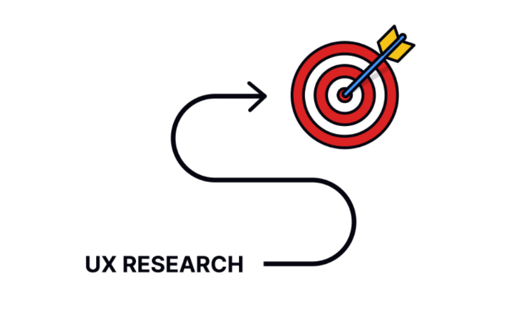
What is UX Design?
UX stands for User Experience Design
Focuses on creating user-centred products
Comprises everything from usability to user satisfaction
1

Slide 3
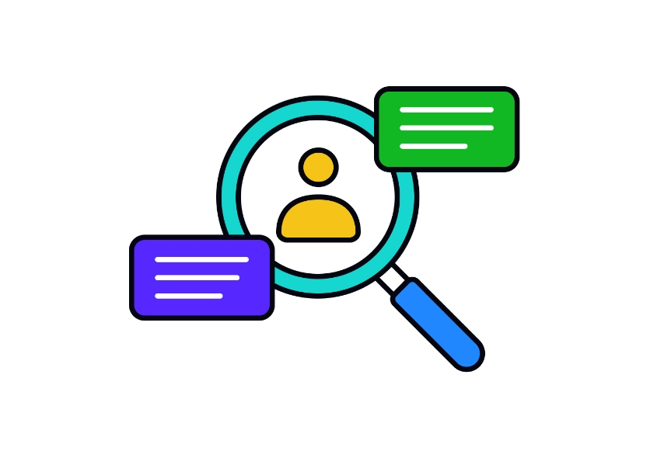
Why is UX important for startups
Improves user acquisition and retention
Reduces development costs
Creates brand loyalty
Boosts customer lifetime value
2

Slide 4
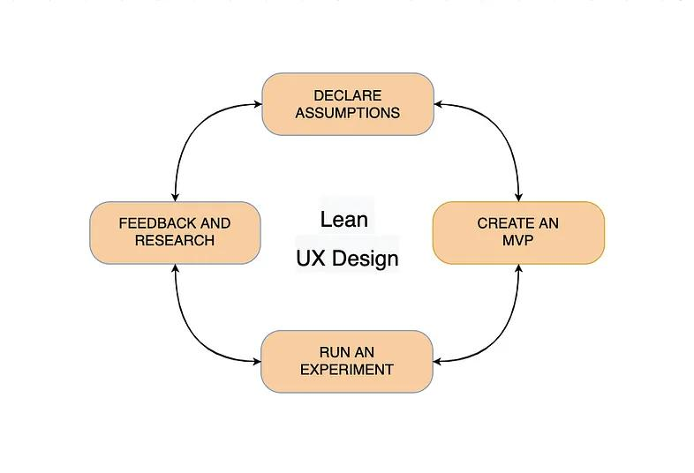
The Lean Approach for Startups
Focuses on rapid iteration and validation.
Prioritizes user research to make inform decisions.
Get’s a minimum viable product (MVP) to market quickly.
3
Notes:
We believe that adding a link to the sizing guide will improve the checkout conversion rate.

Slide 5
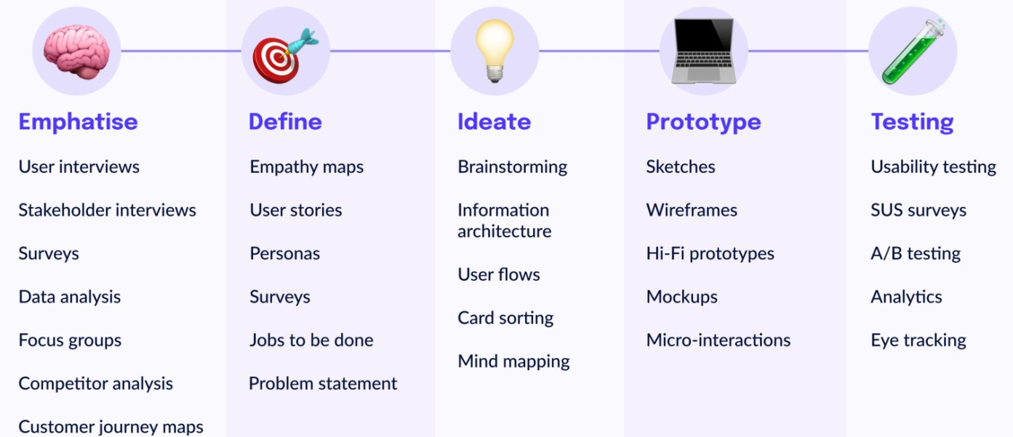
The Traditional Approach to UX - 1
4

Slide 6
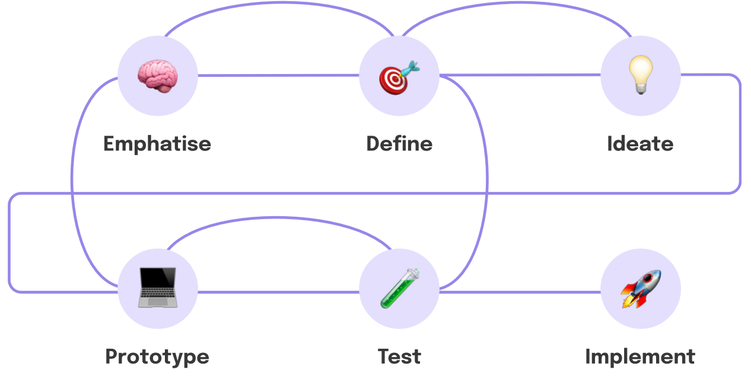
The Traditional Approach to UX - 2
5

Slide 7
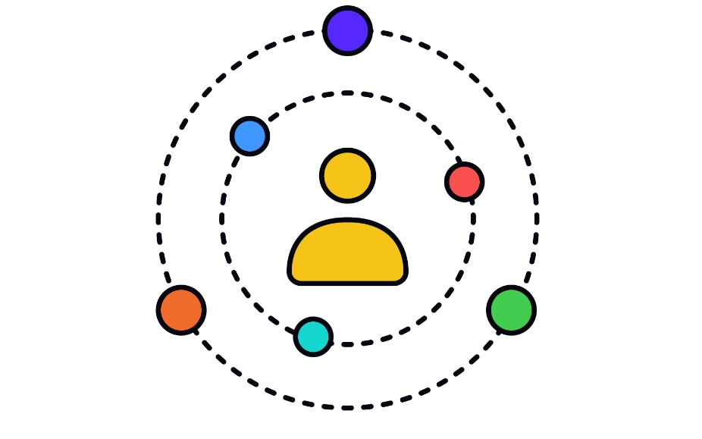
Understanding your users: The foundation of UX
User research is the cornerstone of UX design.
Helps you understand user needs, behaviours and motivations.
Informs design decisions and creates empathy for users.
6

Slide 8
User Personas: Putting a face to your users
A user persona is a fictional representation of your ideal user.
User persona helps you empathise with user needs and make design decisions.
It is based on user research.
7

Slide 9
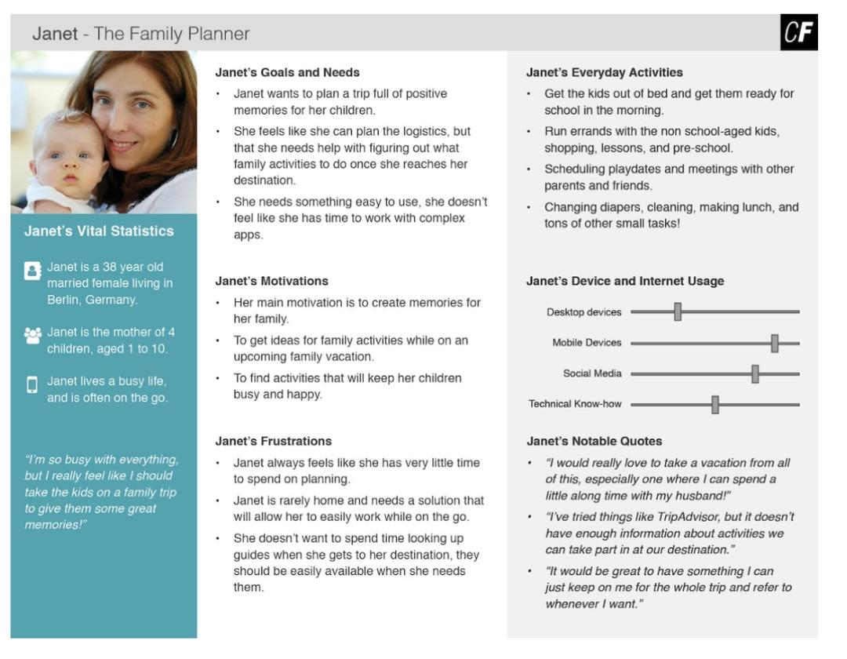
Example of a User Persona – Janet (Family planner)
8
Image credit: CareerFoundry.com

Slide 10
Activity 1: User Persona
Instruction:
Each team will choose a real-life product or service relevant to their startup’s industry: banking app or delivery service
Create a user persona for someone who would typically use this product/service
Define details like demographics, goals, needs, frustrations and tech know-how
Remember to give your persona a name and a short backstory
9

Slide 11

Customer Journey Map
CUSTOMER JOURNEY MAP: LAPTOP MANUFACTURER
Abubakar Saleh, a graphics designer at MSJ Consulting Ltd
Bought a laptop computer
Awareness
Consideration
Decision/
Purchase
Retention
Advocacy
Goals
What is the customer trying to do at this time?
I Need A Laptop
Compare Laptops
Decides O Buy This
Call Support Center
Sharing Experience
Touch Points
How does the customer interact with the organization
Website/Expert Advise
Web Portal /Mobile App /Call Center
Salesperson
Helpdesk
Words Of Mouth / Social Media
Emotions
What is the customer feeling at this point?
Good Pubic Information
Good Comparison And Demo At Store
Great Feelings To Own A Laptop
Good Service
Happy To Spread The Word
Level Of Satisfaction
Or Influence
Who or what is shaping the customer’s decision making process at this stage?
Call Center Expert
Sales Person Interaction
Support Engineer
Social Media Influencers
Pain Points/ Weakness
How does the company let the customer down?
Not Enough Presence
Required Configuration Not Available
No Demo Provided
Wait Time To Address Issue
Improvements Opportunities
What innovative technology can be used to improve the experience?
Websites And Ads
Configuration Comparison To Be Available
Salesperson Should Be Knowledgeable
Quick On Site Supports
How Do I Socialized My Comments
10

Slide 12
Activity 2: User Journey Mapping
Instruction:
Select a core user persona from Activity 1 and select key task they would want to complete using your product/service.
On a piece of paper, map out the user journey through this task.
Include touchpoints, emotions and any pain points they might encounter.
11
Notes:
Touch points are points of interactions with your product.

Slide 13
Building user empathy
Seeing the world through your user’s eyes.
Understanding their frustrations and desires
Creates a more user-friendly product.
SAYS
THINKS
CUSTOMER
DOES
FEELS
12

Slide 14
User Stories
User stories are powerful tool for capturing user needs in a concise format.
Written from the user’s perspective.
Help prioritise features and functionalities.
As a [user role], I want [to do something], so that [I can achieve a goal].
As a [busy entrepreneur ], I want [to be able to quickly order food online], so that [I can save time and stay organized].
13

Slide 15
Information Architecture: Organizing your content
IA is the foundation of a user-friendly product. It is about organizing your content in a way that makes sense to users and help them find what they are looking for quickly and easily
Creates a logical and intuitive user flow.
14

Slide 16
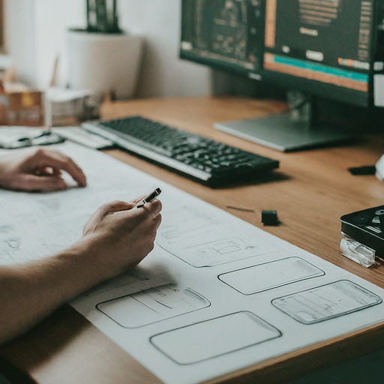
Rapid prototyping: From Pen & Paper to Digital
Rapid prototyping is all about creating a low Fidelity models of your product in order to test with users and get feedback.
Advantage
It saves time and money in identifying usability issues early on.
Allows for quick iteration and testing of different design ideas
Helps to get user feedback early and often.
15

Slide 17
Activity 3: Feature Prioritization
Instruction:
Each team member will brainstorm a list of features they would like to include in their MVP
Write each feature on a separate index card.
Assign a business value score of “High”, “Medium”, “Low” to each feature.
Allow the team to vote using 1-10 to each feature based on its potential impact on user needs and business goal.
16
Notes:
After the votes, reveal the cards and discuss discrepancy and allow the team to re-vote.

Slide 18
Usability testing: The voice of the User
This is the process of observing users interacting with your products to identify any usability problems.
Usability testing ensures that your product is actually usable for your target audience.
How to conduct usability testing
Recruit a small group of users
Give them clear tasks to complete using your product
Observe their behaviour and listen to their feddback
Focus on finding usability issues and not user issues
16

Slide 19
Usability Testing Techniques
There are various usability testing techniques depending on what the user needs and the resources available
Moderated testing: You observe users as they interact with your product and ask them open questions.
Unmoderated testing: users complete tasks using the product on their own and record their screen and audio.
Remote testing: Users complete tasks from the comfort of their own homes.
17

Slide 20
Design Thinking Approach: A User centered Approach
This method is also called human centred approach to problem-solving and a valuable tool for start-ups. It involves understanding the needs of your user, brainstorming solutions, and iterating on your ideas based on user feedback.
This is achieved through a five stage design thinking process:
Emphatise: Understand the needs of the user
Define: define the problem you are trying to solve
Ideate: Brainstorm potential solutions
Prototype: create a prototype of your solution.
Test: test your prototype with users and get feedback
18

Slide 21
Wireframing: Building the skeleton of your App
Wireframes are low fidelity mockup of your product’s interface. It focuses on the layout and functionality of the UI elements without getting bogged down in the visual design.
Communicate design ideas
Identify issues early on
Refine the information architecture
19

Slide 22
Usability Heuristics: Design guidelines for Better UX
These are set of guidelines that can help you design user-friendly products, they are based on best practices and research in the field of UX design.
Visibility of system status
Match between system and the real world
User control and freedom
20

Slide 23
UI Design: Making your Product Beautiful & Usable
UI design is all about the visual elements of your products such as the layout, typography and colour scheme.
Aesthetics should not be traded with functionality and usability.
Keep it simple
Use clear and consistent visual elements
Design for your target audience
21

Slide 24
UI Design tools
Figma
Adobe XD
Sketch
Miro
22

Slide 25
Activity 4: Low-Fi Prototyping
Instruction:
Based on the user journey map and chosen task, create a Low-fidelity prototype of the key screens users would interact with.
Use simple tools like pen and paper or whiteboards.
Focus on functionality and user flow
Mini-Activity
Find one user outside the workshop and with their consent explain the task you want them to complete using your Low-Fi prototype.
Observe their behaviour and listen to their feedbacks.
23
Notes:
Some answers may reveal confusions about navigation, unclear instruction or difficulty finding certain features

Slide 26
Conclusion
Remember, UX design is an iterative process that has no finish line. It is about continually learning from your users and refining your product based on their feedback.
Focus on user needs
24

